Slide 1

Anatomy of a program

Slide 2
Outline
In this presentation, we will:
Define the components of a program
Pre-processor directives
Statements
Blocks of statements
Function declarations and definitions

Slide 3
Pre-processor directives
#include <iostream>
int main();
int main() {
std::cout << "Hello world!";
std::cout << std::endl;
return 0;
}

Slide 4
Pre-processor directives
Indicates that a particular standard library or file should be included in the compilation
C++ Standard libraries contain functionality available to all programmers except perhaps in embedded systems
Possible to include other source code you or others have written
#include <iostream>
All pre-processor directives start with a “#”
Pre-processor directives are not part of the C++ programming language

Slide 5
Statements
#include <iostream>
int main();
int main() {
std::cout << "Hello world!";
std::cout << std::endl;
return 0;
}

Slide 6
Statements
int main();
std::cout << "Hello world!";
std::cout << std::endl;
return 0;
A statement may always be described a
the introduction (or “declaration”) of a name (or “identifier”)
an action that is being performed on data
A statement is always terminated by a semi-colon

Slide 7
Statements
Some sample statements from the nasa core Flight System Memory Manager Application:
Valid = FALSE;
BytesRemaining = 0;
MM_AppData.ErrCounter++;
CFE_EVS_SendEvent(MM_PSP_READ_ERR_EID, CFE_EVS_ERROR,
"PSP read memory error: RC=0x%08X, "
"Src=0x%08X, Tgt=0x%08X, Type=MEM16",
(unsigned int)PSP_Status,
(unsigned int)DataPointer16,
(unsigned int)&ioBuffer16[i] );
break;

Slide 8
A block of statements
A block of statements is zero or more statements surrounded by braces
Statements are executed one at a time in the order they appear
One statement must finish executing before the next starts
{
std::cout << "Hello world!";
std::cout << std::endl;
return 0;
}

Slide 9
A block of statements
A sample block of statements from the nasa core Flight System Memory Manager Application:
{
Valid = TRUE;
MM_AppData.LastAction = MM_LOAD_FROM_FILE;
MM_AppData.MemType = FileHeader->MemType;
MM_AppData.Address = DestAddress;
MM_AppData.BytesProcessed = BytesProcessed;
strncpy( MM_AppData.FileName,
FileName, OS_MAX_PATH_LEN );
}

Slide 10
Function declarations and definitions
#include <iostream>
int main();
int main() {
std::cout << "Hello world!";
std::cout << std::endl;
return 0;
}
Function declaration
Function definition
The statements executed when the
function is called is also referred to
as the function body.

Slide 11
Function declarations
From your secondary school mathematics courses, you have seen:
The names of these functions are sin and gcd:
sin has one real parameter and evaluates to a real
gcd has two integer parameters and evaluates to an integer

Slide 12
Function declarations
A function declaration indicates to the compiler:
That a function with a specific name exists
The name is called the identifier of the function
The function’s parameters
What it returns
The declaration:
int main();
indicates:
The name of the function is main
It has no parameters
It returns an int
An integer

Slide 13
Function declarations
The function declarations for sin and gcd would be:
double sin( double x );
int gcd( int m, int n );
indicates:
The names of the functions are sin and gcd
The first has one parameter, the second has two
The first returns a double, the second an int

Slide 14
Function definition
A function definition is the function declaration immediately followed by a block of statements
This block of statements is also called the body of the function
These statements are executed when the function is run
The three statements executed when main() is called include:
Printing “Hello world!” to the console output,
Printing an end-of-line character to the console output, and
Returning the integer 0
int main() {
std::cout << "Hello world!";
std::cout << std::endl;
return 0;
}

Slide 15
Function definition
The main function is especially important in C++
There can by many functions, but if source code is compiled into an executable, when that executable is run, it is the main() function that is first called

Slide 16
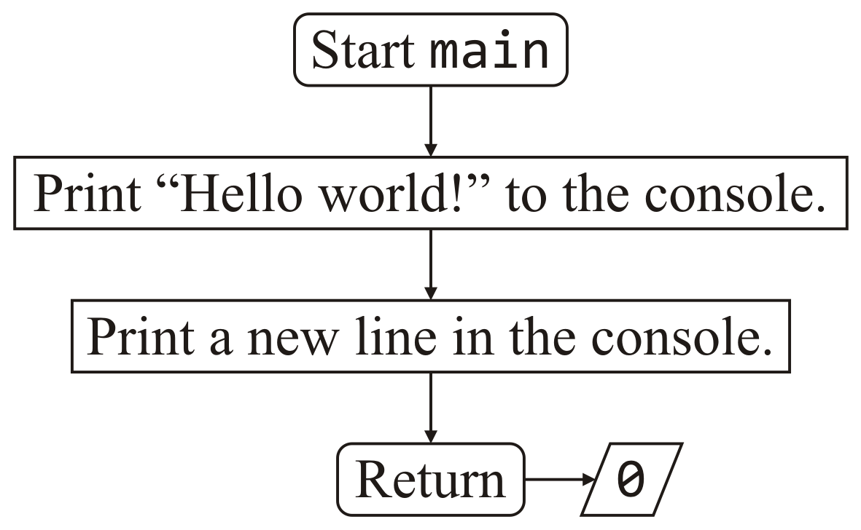
Flow charts
A flow chart is a diagrammatic means of documenting what a function does
int main() {
std::cout << "Hello world!";
std::cout << std::endl;
return 0;
}

Slide 17
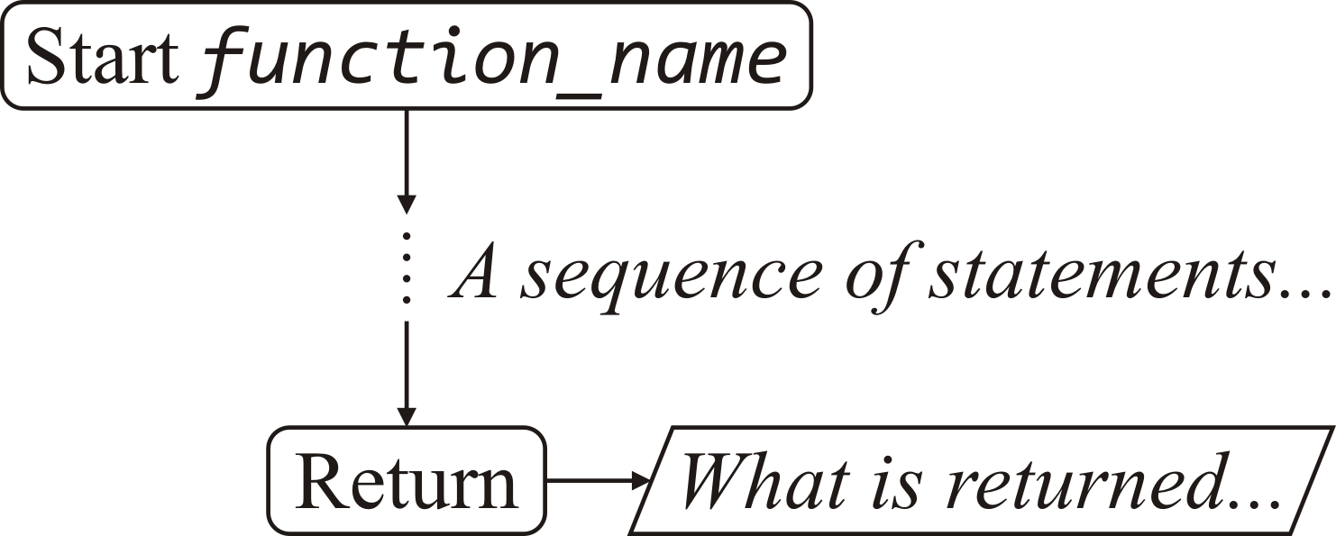
Flow charts
The start and end of functions are indicated with rounded boxes
Any internal output is marked with a parallelogram
Often, the descriptions are point form or English prose

Slide 18
Flow charts
Statements are shown in rectangular boxes
The order of the execution of the statements is indicated by the arrows
Again, the descriptions are in point form or English prose
They tell the reader what is meant to happen
These are programming language independent

Slide 19
Matching delimiters
As in your mathematics courses, ( ), [ ], and { } are used to group mathematical expressions
We will call these parentheses, brackets and braces
For clarity, we may use the terms round parentheses, square brackets, and curly braces
(, [, and { are referred to as opening delimiters
while ), ], and } are referred to as closing delimiters
Given an opening delimiter, its matching closing delimiter is next closing delimiter that does not have a closer matching opening delimiter
Each opening delimiter must have a matching closing delimiter
{ ( [ ( ( ) [ ( ) ] ) { } ] { } [ ] ) } [ ( ) { [ ] } ]

Slide 20
Summary
In this presentation, you now
Described the include pre-processor directive
Defined a statement
Operators and function calls terminated by a semi-colon
Defined a block of statements
Zero or more statements surrounded by braces
Defined function declarations and definitions
Described and introduced flow charts

Slide 21
References
[1] Wikipedia
https://en.wikipedia.org/wiki/Statement_(computer_science)

Slide 22
Acknowledgments
Proof read by Dr. Thomas McConkey and Charlie Liu.

Slide 23



Colophon
These slides were prepared using the Georgia typeface. Mathematical equations use Times New Roman, and source code is presented using Consolas.
The photographs of lilacs in bloom appearing on the title slide and accenting the top of each other slide were taken at the Royal Botanical Gardens on May 27, 2018 by Douglas Wilhelm Harder. Please see
https://www.rbg.ca/
for more information.

Slide 24
Disclaimer
These slides are provided for the ece 150 Fundamentals of Programming course taught at the University of Waterloo. The material in it reflects the authors’ best judgment in light of the information available to them at the time of preparation. Any reliance on these course slides by any party for any other purpose are the responsibility of such parties. The authors accept no responsibility for damages, if any, suffered by any party as a result of decisions made or actions based on these course slides for any other purpose than that for which it was intended.

